Slide 1

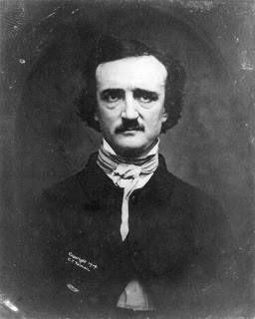
Biography of
Edgar Allan Poe
Enter the enigmatic world of Edgr Allan Poe if you dare…
By: GATE 7

Slide 2


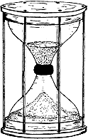





Timeline
Read More
Cause of Death
Table of Contents
Edgar Allan
Poe
ABC Biography
Family Tree

Slide 3

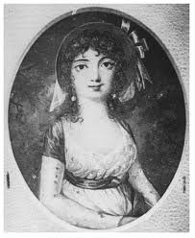
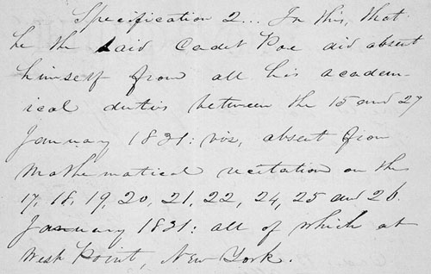
Timeline
1811- Elizabeth Arnold Poe dies of tuberculosis and because David Poe Junior abandoned his family, Edgar was taken into the care of John Allan and Frances Allan.
1809- Edgar Allan Poe was born.
1826- Poe went off to Virginia University to study for one term.
1810- Edgar’s younger sister, Rosalie, was born.
1815- Attended boarding schools in England for 6 years.
1807- Edgar’s older brother William Henry was born.
1827- Edgar gambled and got into debt and when he asked for money from John Allan, Allan refused. The two got into a quarrel and at the end Allan kicked Poe out with no where to live and no money. Poe then went to serve in the United Stated Army on May 26th, 1827.

Slide 4
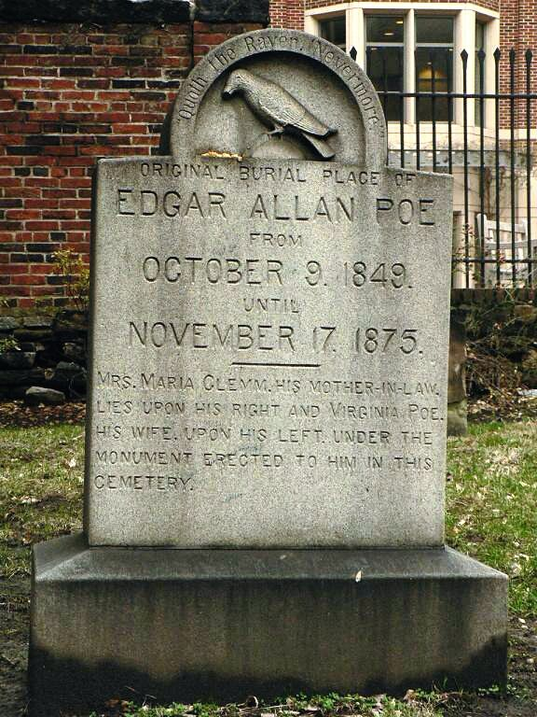
Timeline
1847- Virginia Clemm dies of tuberculosis and caused Poe to rely more on alcohol which made he erratic.
1829- Poe went to live in Baltimore with his aunt, Maria Poe Clemm.
1840- The Raven was published.
1849- Found unconscious outside of a voting booth and died on October 7th. Poe is buried in the Old Westminster Burying Ground in Baltimore.
1836- Poe marries his cousin, Virginia Eliza Clemm in Richmond.
1846- Rented a cottage in the Bronx where he spent the last three years of his life.
Table of Contents

Slide 5
ABC Biography
Arthur Gordon Pym- This is a narrative and the only novel Poe would ever finish in his lifetime.
Boston- Birthplace of Edgar Allan Poe (Home is located on Carver Street).
Carver Street- Street in Boston that Poe’s home was located on. Additionally, Poe’s mother acted on the theater on this street during her acting days.
David Poe Jr. - Name of Edgar’s biological father who left the family for an unknown reason.
Continue
Table of Contents

Slide 6
Elizabeth Arnold Poe- Mrs. Poe was Edgar’s biological mother, who died when Poe was only 2 years old of tuberculosis. She was a crowd pleasing actor from England.
Fordham, Bronx, NY- This is where Poe rented a small cottage and spent the last three years of his life. Additionally, his wife died in this home.
Grotesque and Arabesque Tales- This is a collection of short stories written by Poe published in 1840.
Henri Le Rennet- The pseudonym that Poe used during his early years of writing. He was inspired to use it because of his brother, Henry, who was fascinated with French names.
Continue
Table of Contents

Slide 7
Island of the Fay- A short poem by Poe about music, the nature of God and the universe, and life and death. (Fay means fairy or elf)
John Allan- John Allan took care of Poe ever since he was 2 and then cared for him until they got into a quarrel when Poe was 17 and Allan kicked him out onto the streets.
Kennedy- John Peddleton Kennedy was a statesman and author who awarded Poe in 1833 when he judged a contest in Baltimore. He awarded Poe with first prize for “MS. Found in a Bottle”.
Lenore- One of Poe’s most famous poems, and the lost lover he mentions of in his bestselling poem “The Raven.”
Continue
Table of Contents

Slide 8
Macabre- One of the many writing styles Poe used in his poems, short stories, and other works. The books that are macabre based are some of his best of all time.
Nevermore! - This word is used a multitude of times in Poe’s very famous poem The Raven. The crow in the story always crows out to the depressed narrator Nevermore, speaking of never seeing his lover, Lenore.
O val Portrait- This Poe story is a tragic love story about a painter who is so obsessed with painting the perfect picture of his wife that he does nothing else.
Pit and the Pendulum- This is one of Poe’s bestselling short stories, published in 1843. The story is about an unnamed narrator who describes being tortured during the Spanish Inquisition in 1478.
Continue
Table of Contents

Slide 9
Queen of May Ode- This poem was published around
April, 1836.
Richmond, VA- This city is where Poe married his wife, Virginia, and spent some time in his earlier years. He also served as a lieutenant for the color guard in Richmond.
Sunday, October 7, 1849- This was the day that Poe fell into unconsciousness and died from a mysterious cause. Some believe he was mugged, had rabies, caught a brain tumor, and other theories have arose. He was never able to tell the doctors what happened to him.
Tuberculosis- A deadly disease that many caught and died from during the early to mid-1800s. Many of Poe’s relatives, including his wife, Virginia, died because of it.
Continue
Table of Contents

Slide 10
Ulalume- This story written in 1847, the narrator of the story mostly speaks about the loss of his wife, similar to “The Raven.”
Virginia Clemm- She is Poe’s cousin and wife whom he married in 1837 when he was 27 and she was only 13.
West Point Military Academy-Poe enlisted here and served as a cadet for three years. He continued his writing here as well. Poe was dismissed on “gross neglect of duty” and “disobedience of orders” on January 28, 1831. Truly, Poe must have been trying really hard to get himself kicked out!
Xing a Paragrab- This short silly story about how a man opens a newspaper shop across the street from a regular one. He writes this whole paragraph using the letter “O”. Then, he is told he cannot use that letter anymore so he replaces all of the O’s with X’s!
Continue
Table of Contents

Slide 11
Youth I have Known One- This is another poem written during the time of Edgar Allan Poe.
Zante: This short poem, which was written in 1887, talks about the true beauty of the Zante island and how it is similar to his wife who was passed away.
Table of Contents

Slide 12
Cause of Death
Many different theories have been postulated to Edgar Allan Poe, the prolific and critically acclaimed author’s cause of death. The facts are that he was lying unconscious next to a voting booth in Baltimore, Maryland. Additionally, he was wearing someone else’s clothing. There are countless numbers of theories that have been developed by people. The most famous are that he may have died of rabies, alcoholism, or cooping, a grotesque manner of drugging people to vote for a specific person. Some universities have done extensive research on this, and they have all come to different conclusions. The king of mystery and horror’s own death was a mystery!
Continue
Table of Contents

Slide 13
The first thing that pops into everyone’s mind when they think of Poe’s death is alcoholism. Poe was an alcoholic most of his life, and his temper changed every time he drank. However, in an analysis done by the University of Maryland Medical Center, they say that Poe had not drank a sip of alcohol in 6 months. This leads to eliminate that theory. Another theory that has risen is the Cooping theory. Cooping was done during election days, and this is when Poe was found on the street. Also, he was next to a voting booth. Gangs drugged people and sometimes switched their clothing to vote again and again. This leads to validation of the theory because of Poe's location, and dress. (he was wearing someone else's clothes at the time).
Continue
Table of Contents

Slide 14
An investigation led by Doctor Michael Benitez of the University of Maryland Medical Center found that the only probable cause of death was rabies. Many say that Poe was experiencing abnormal behavior, delirium, and agitation. These are all symptoms of rabies, which usually starts to affect the body 2 to 3 weeks after the initial entry. Additionally, Poe had to be kept under restraint due to violent seizures that occurred periodically. This also is a symptom of rabies. Clearly, Poe may have had rabid occurrences because of these horrific symptoms.
Clearly, many people have created theories about Poe's enigmatic death. These theories have been based off of facts and observers testimonies. We have come to a conclusion that rabies was the best theory of Poe's cause of death. The symptoms that he was experiencing truly show that rabies was the most probable cause.
Table of Contents

Slide 15
Family Tree
David Poe
Sarah Poe
Jane McBride Poe
John Poe
Alexander Poe
Anne Poe
David Poe
Mary Poe
Information:
Great Great Grandparents: highlight
Great Grandparents: highlight
Grandparents: highlight
Parents: highlight
Siblings: highlight
George Poe
William Poe
Robert Poe
Elizabeth Cairnes Poe
Samuel Poe
Jane Poe
Hester Poe
John Poe
Mary Poe
John Hancock Poe
James Poe
William Poe
George Washington Poe
David Poe Jr.
Samuel Poe
Elizabeth Arnold
Henry Arnold
Maria Poe
Elizabeth Poe
Elizabeth Arnold Hopkins
Henry
Edgar Allan Poe
Table of Contents
Rosalie

Slide 16
Read More Page
Want to read some of Edgar Allan Poe’s poetry and short stories? Click the links below and have fun reading!
The Raven:
http://poestories.com/read/raven
Annabel Lee:
http://poestories.com/read/annabellee
The Tell-Tale Heart:
http://poestories.com/read/telltaleheart
The Angel of the Odd: http://poestories.com/read/angeloftheodd
The Bells:
http://poestories.com/read/bells
Many more stories and poetry can be found at: http://poestories.com/index.php
Table of Contents

Slide 17
Works Cited Page-Information
Mrs. Virginia Clemm Poe. (2014, August 12). Retrieved November 13, 2014
"Virginia Poe's Sad Acrostic Valentine for Edgar Allan." Slate Magazine. 1 Jan. 2014. Web. 12 Nov. 2014
Adams, Matthew. "Biography of Elizabeth Arnold Hopkins Poe Mother of Edgar Allan Poe." Fine Arts 360. 1 Jan. 2014. Web. 12 Nov. 2014
Sowersby, Kris. "Edgar Allan Poe." Poets.org. Academy of American Poets. Web. 12 Nov. 2014.
"Edgar Allan Poe Biography." Bio.com. Ed. Laura Grim and Leanne French. A&E Networks Television, 1 Jan. 2014. Web. 12 Nov. 2014.
Edgar Allan Poe. (n.d.). Retrieved November 11, 2014.
The Edgar Allan Poe Society of Baltimore. (2009, June 21). Retrieved November 11, 2014
"John Pendleton Kennedy." Edgar Allan Poe Society of Baltimore. 27 July 2014. Web. 15 Nov. 2014
"Edgar Allan Poe." - Biography and Works. Search Texts, Read Online. Discuss. Web. 12 Nov. 2014.
"The Poems of Edgar Allan Poe." Edgar Allan Poe Society of Baltimore. Web. 12 Nov. 2014
"Poe's Life- Who Is Edgar Allan Poe?" Poe's Life. Poe Museum. Web. 1 Jan. 2014.
"Edgar Allan Poe Mystery." University of Maryland Medical Center. Web. 12 Nov. 2014.
“Bio.com.” A&E Networks Television. Web. 12 Nov. 2014.
"A Biography Of Edgar Allan Poe." Poe Stories. Web. 12 Nov. 2014.
"Biography of Edgar Allan Poe." http://poestories.com/biography.php. Poestories.com. Web. 13 Nov. 2014.
"Prologue: Pieces of History." » Edgar Allan Poe’s Military Career? Nevermore! Web. 14 Nov. 2014. <http://blogs.archives.gov/prologue/?p=3600>.
"Text: Thomas Ollive Mabbott (and E. A. Poe), “To Zante,” The Collected Works of Edgar Allan Poe — Vol. I: Poems (1969), Pp. 310-312 (This Material Is Protected by Copyright)." Edgar Allan Poe Society of Baltimore. 10 June 2011. Web. 17 Nov. 2014.
More

Slide 18
Works Cited Page-Images
Escabar, J. (n.d.). Club de Pensadores Universales. Retrieved November 13, 2014/
"Open Doors, Open Classrooms, Open Minds | The Jose Vilson." The Jose Vilson. Web. 15 Nov. 2014.
"Feather Painting - HowStuffWorks." HowStuffWorks. The Editors of Publications International. Web. 17 Nov. 2014.
"Navigational Methods: Newfoundland and Labrador Heritage." Navigational Methods: Newfoundland and Labrador Heritage. 2000
Crenshaw, David. "Rhinebeck Child and Family Center, LLC- The Tree at the Top of the Hill."Rhinebeck Child and Family Center, LLC- The Tree at the Top of the Hill. 2014. Web. 17 Nov. 2014.
“Open Book Clip Art." Open Book Clip Art. Web. 17 Nov. 2014
“Books (Book) Icon #115226." Icons Etc. Web. 17 Nov. 2014.
"Question-mark - Monkee-Boy Blog." MonkeeBoy Blog RSS2. 27 May 2014. Web. 17 Nov. 2014.
Au, Oscar. "SM2608 Hardware Hacking Workshop." SCM Sweb. 2013. Web. 17 Nov. 2014.
“Text: Dwight R. Thomas and David K. Jackson, “Illustration 01”, The Poe Log (1987), P. 2” Edgar Allan Poe Society of Baltimore, 11 Sept. 2010. Web. 18 Nov. 2014

